Slide 1
My title
Thesis presentation

Slide 2
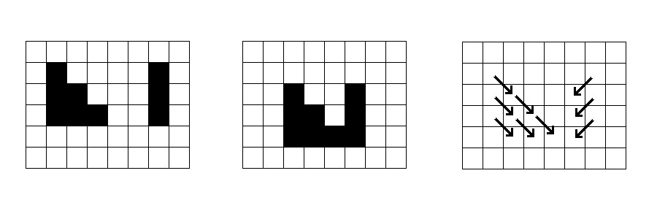
What is optical flow

Slide 3
Applications of optical flow

Slide 4
Motivation

Slide 5
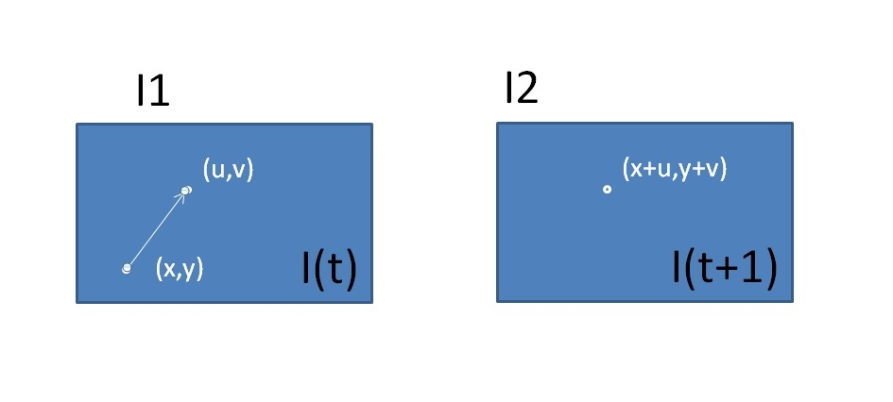

Brightness assumption

Slide 6
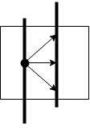

Aperture problem
Solve
$$I\left(x,y\right)=I(x+u,y+v)$$
u and v.

Slide 7
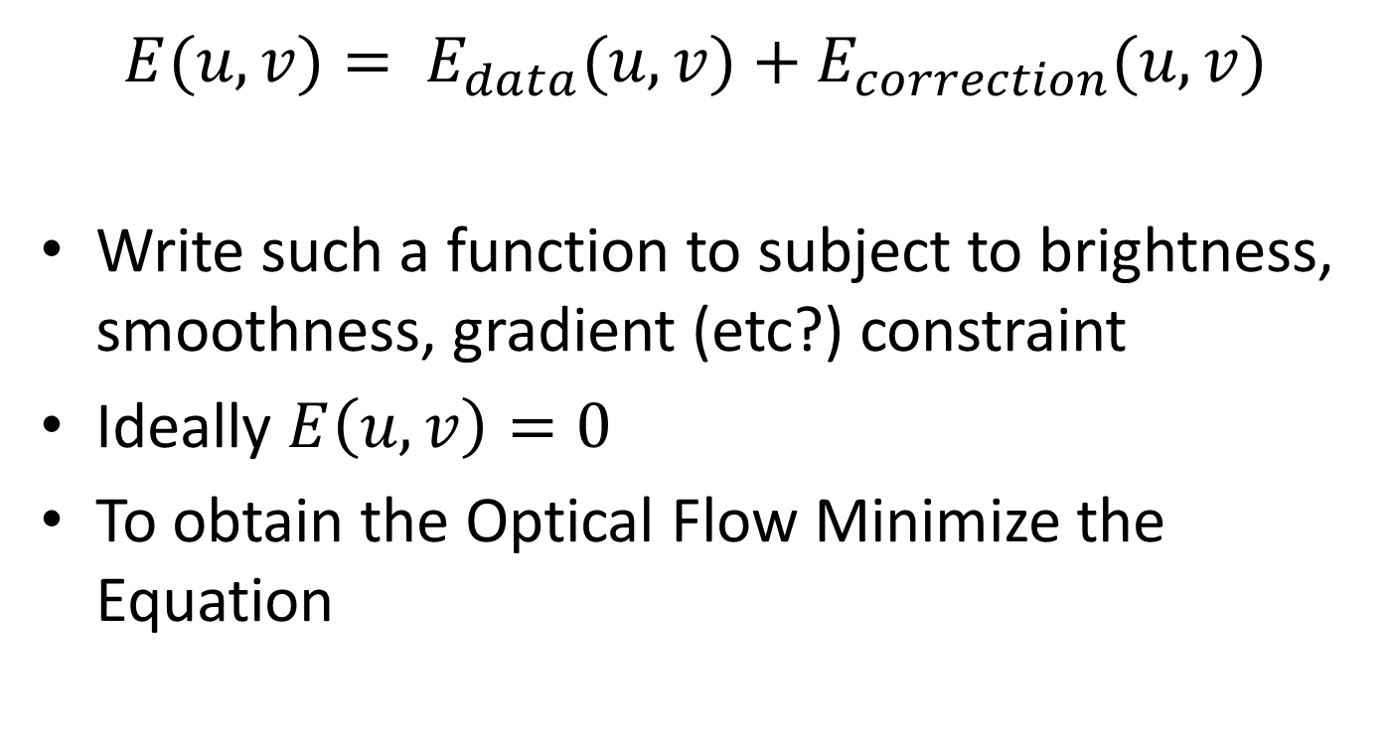
Formulation of the Energy Function
$$E(u,v)= E_{data}(u,v)+E_{correction}(u,v)$$
Write such a function to subject to brightness, smoothness, gradient (etc?) constraint
Ideally $E\left(u,v\right)=0$
To obtain the Optical Flow Minimize the Equation

Slide 8
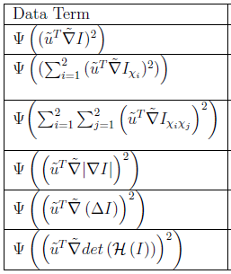
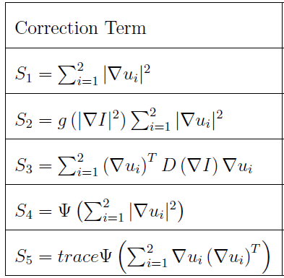
Formulations of the Energy function Examples

Slide 9
Coarse-to-fine approach
Based on Gaussian or Lagrange Pyramids
Detects large displacements
??

Slide 10
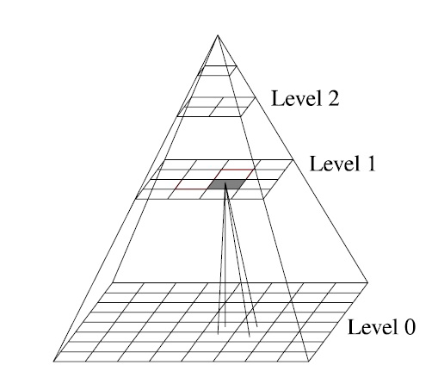
Coarse-to-fine approach

